Slide 1
Here's your outline to get started
Key facts about your topic
Environmental remediation deals with the removal of pollution or contaminants from environmental media such as soil, groundwater, sediment, or surface water. This would mean that once requested by the government or a land remediation authority, immediate action should be taken as this can impact negatively on human health and the environment.
See more: Open the Notes below for more information.
Notes:
QuickStarter has created an outline to help you get started on your presentation. Some slides include information here in the notes to provide additional topics for you to research.

Slide 2
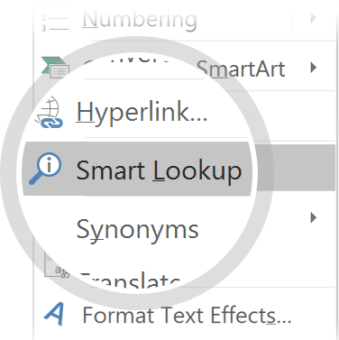
Related topics to research
Soil vapor extraction
Phytoremediation
In situ chemical oxidation
Sewage treatment
Betty Harris
Green bridge
Use Smart Lookup to learn more
1
Highlight one of the related topics
Right-click on the topic
Choose "Smart Lookup"
2
3

Slide 3
Remediation of Environmental Lead Contamination
Specifically, lead contamination from long term use as a government firing range

Slide 4
Contents
Remediation standards
Site assessment
Funding remediation
Mapping remediation
Technologies
Community consultation and information
Incremental health risk
Impacts of funding remediation
Examples of major remediation projects

Slide 5
Remediation standards

Slide 6
Site assessment

Slide 7
Funding remediation

Slide 8
Mapping remediation

Slide 9
Technologies
Look in the slide notes below for topics to consider talking about
Notes:
Consider talking about:
Thermal desorption
Excavation or dredging
Surfactant enhanced aquifer remediation (SEAR)
Pump and treat
Solidification and stabilization
In situ oxidation
Soil vapor extraction
Nanoremediation
Bioremediation
Collapsing air microbubbles

Slide 10
Community consultation and information

Slide 11
Incremental health risk

Slide 12
Impacts of funding remediation

Slide 13
Examples of major remediation projects
Look in the slide notes below for topics to consider talking about
Notes:
Consider talking about:
Homebush Bay, New South Wales, Australia
Bakar Ex Cokeing Plant Site, Croatia

Slide 14
Works cited

