Slide 1
Here's your outline to get started
Key facts about your topic
Soil contamination or soil pollution as part of land degradation is caused by the presence of xenobiotic chemicals or other alteration in the natural soil environment. It is typically caused by industrial activity, agricultural chemicals, or improper disposal of waste. The most common chemicals involved are petroleum hydrocarbons, polynuclear aromatic hydrocarbons (such as naphthalene and benzo(a)pyrene), solvents, pesticides, lead, and other heavy metals. Contamination is correlated with the degree of industrialization and intensity of chemical usage.
See more: Open the Notes below for more information.
Notes:
QuickStarter has created an outline to help you get started on your presentation. Some slides include information here in the notes to provide additional topics for you to research.

Slide 2
Related topics to research
Plastic pollution
Environmental issues in India
Pollution in Canada
Pollution in China
Pollution in the United States
Trichloroethylene
SaltMod
SahysMod
Uranium in the environment
Radium and radon in the environment
Use Smart Lookup to learn more
1
Highlight one of the related topics
Right-click on the topic
Choose "Smart Lookup"
2
3

Slide 3
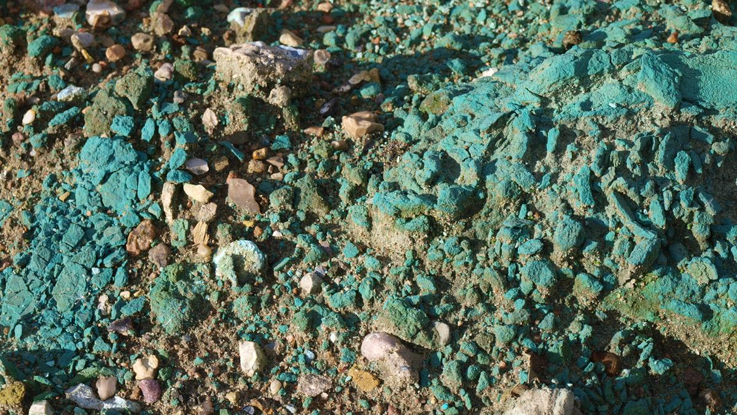
Soil contamination

Slide 4
Contents
Causes
Health effects
Ecosystem effects
Cleanup options

Slide 5
Causes
Look in the slide notes below for topics to consider talking about
Notes:
Consider talking about:
Pesticides and herbicides
Agents of war

Slide 6
Health effects

Slide 7
Ecosystem effects

Slide 8
Cleanup options

Slide 9
Works cited

